Slide 1

Project Title - Enhancing Diabetes Prediction with Machine Learning Models
Name : SHAIK SHOAIB
Student ID : STU6511bfb94ed821695662009

Slide 2

PROBLEM STATEMENT
How might we enhance the accuracy and interpretability of diabetes prediction models to empower healthcare professionals in identifying individuals at risk, thereby facilitating early intervention and personalized care?"
This problem statement suggests a focus on improving both the performance and interpretability of your machine learning models for diabetes prediction, with the ultimate goal of aiding healthcare professionals in making informed decisions for patient care. Adjust the wording based on the specific objectives and goals you have in mind for your project.

Slide 3
Project Description Project Title: “Enhancing Diabetes Prediction with Machine Learning models" This project focuses on developing and comparing two machine learning models—Random Forest Classifier and Support Vector Machine (SVM)—for predicting diabetes based on health-related attributes. The dataset includes factors such as glucose levels, blood pressure, BMI, etc. The goal is to enhance accuracy while ensuring interpretability for healthcare professionals. By evaluating model performance and visualizing interpretability, the project aims to empower early intervention and personalized care for individuals at risk of diabetes. The findings contribute to the understanding of machine learning applications in healthcare. Significance: This project addresses the critical need for accurate and interpretable diabetes prediction models. Healthcare professionals can benefit from these models by gaining insights into influential factors and making informed decisions for patient care. The project's outcomes have the potential to improve diagnostic processes and contribute to more effective healthcare strategies for diabetes management.

Slide 4

WHO ARE THE END USERS?
Healthcare Professionals:
Doctors, nurses, and other healthcare practitioners who can utilize the predictive models to identify individuals at risk of diabetes during routine check-ups.
Healthcare professionals can integrate the model predictions into their decision-making processes, enabling early interventions and personalized care plans.
Patients:
Individuals who may benefit from early detection of diabetes risk. The project's outcomes could empower patients to proactively manage their health and make lifestyle changes to reduce the risk of diabetes.
Healthcare Institutions:
Hospitals, clinics, and healthcare institutions that can incorporate the developed models into their health information systems for systematic and efficient risk assessment.
Researchers and Data Scientists:
Professionals in the field of healthcare analytics and machine learning who can explore the project's methodology, findings, and potentially contribute to further improvements in diabetes prediction models.

Slide 5

Technology Used
Programming Language - Python
Machine Learning Models –
Random Forest Classifier: Implemented using scikit-learn, this ensemble learning model is utilized for predicting diabetes based on the input features.
Support Vector Machine (SVM): The project includes the implementation of an SVM classifier from scikit-learn for diabetes prediction
Libraries Used - Pandas , Matplotlib , NumPy, Scikit-learn, Seaborn

Slide 6
MODELLING -
In this diabetes prediction project, two machine learning models have been employed to assess their effectiveness in predicting the likelihood of diabetes based on a given set of health-related features.
Firstly, a Random Forest Classifier was utilized, leveraging the ensemble learning technique. This model is built upon an ensemble of decision trees, each contributing to the final prediction. Random Forests are known for their robustness, handling complex relationships in data, and offering high accuracy. The Random Forest model aids in capturing diverse patterns within the dataset, contributing to a comprehensive and reliable prediction framework.
Additionally, a Support Vector Machine (SVM) classifier was implemented. SVM is a powerful supervised learning algorithm used for classification and regression tasks. In this project, the SVM model is trained to discern between individuals with and without diabetes based on the specified features. SVMs are effective in high-dimensional spaces and are particularly useful when dealing with non-linear relationships in data. The project employs these two distinct models to provide a comparative analysis of their performance in the context of diabetes prediction, offering insights into the strengths and limitations of each approach.

Slide 7
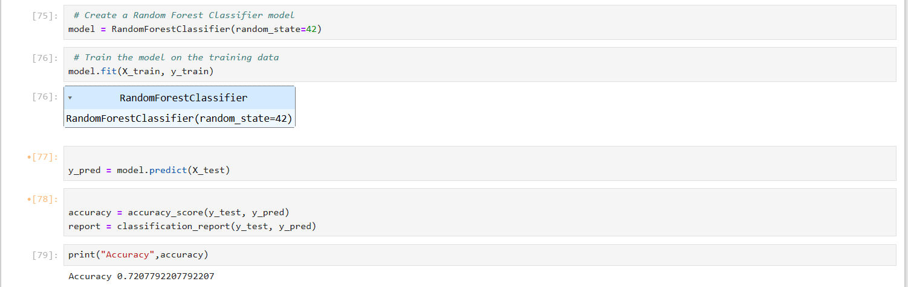
RESULTS
Random Forest Classifier:
Accuracy: 72.07%

Slide 8
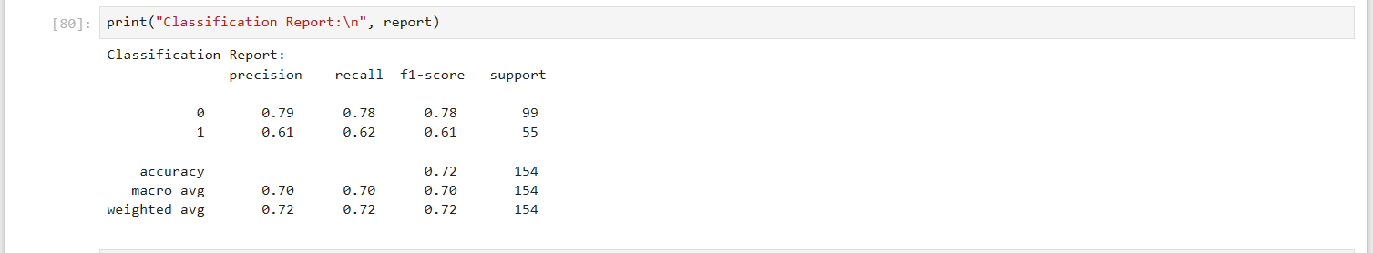
RESULTS
Random Forest Classifier:
Classification report:

Slide 9
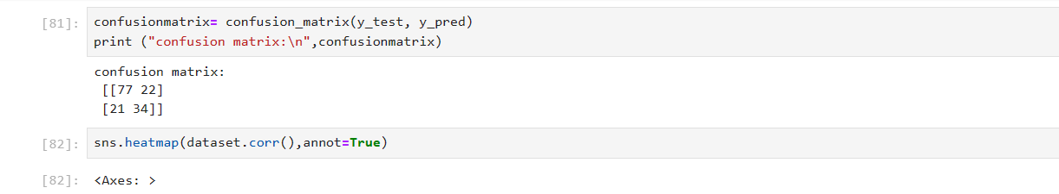
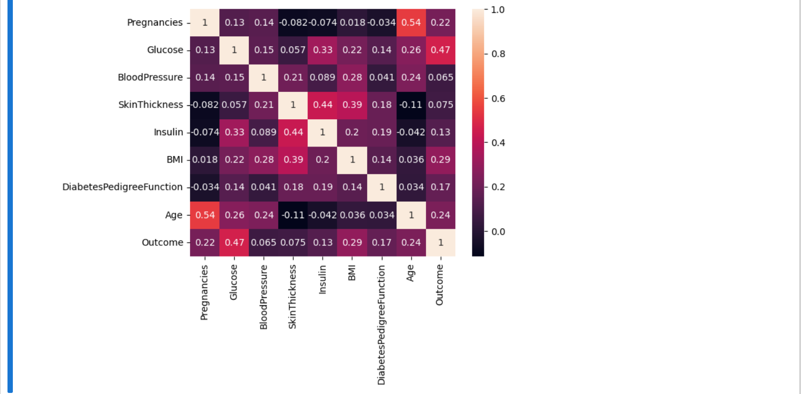
RESULTS – RFC_Confusion matrix
Random Forest Classifier:
Confusion matrix:

Slide 10
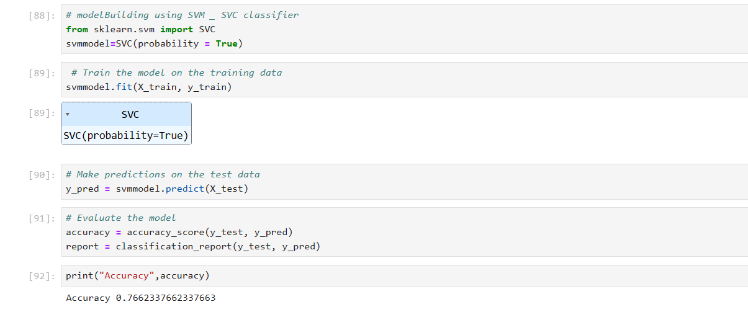
RESULTS
SVM classifier:
Accuracy: 76.6%

Slide 11
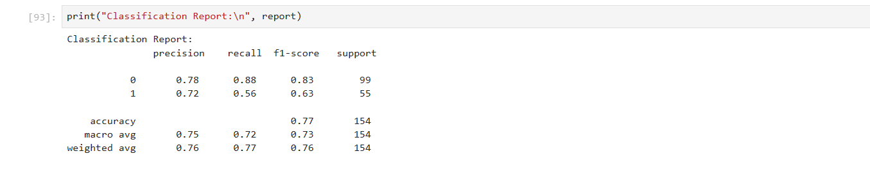
RESULTS
SVM classifier:
Classification report:

Slide 12
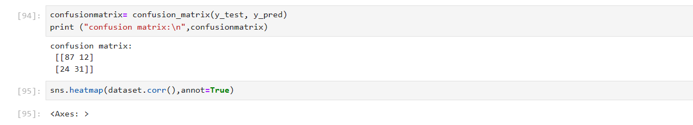
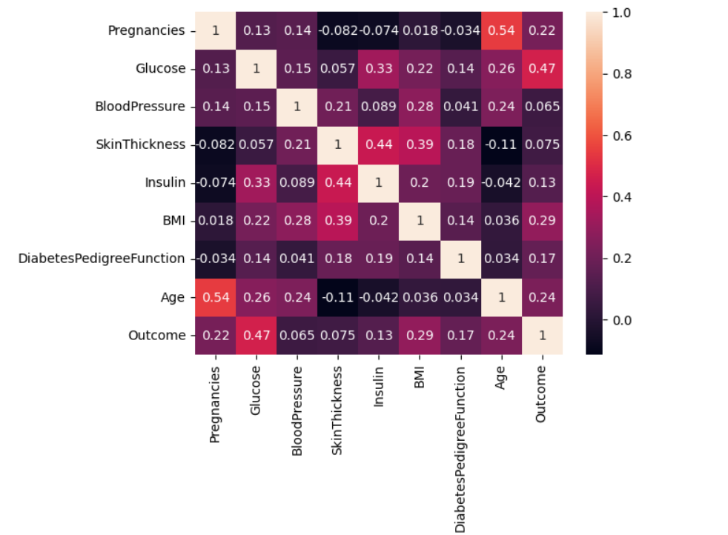
RESULTS – SVM_Confusion matrix

Slide 13
Thank you
My project codes Github link:
https://github.com/sshaikshoaib/VOIS_TECH/tree/main
My project codes drive link:
https://drive.google.com/drive/folders/1RUYBKMZmf7NXXMdBP2ibqhMVrjpMohcS?usp=sharing
.
.

